Slide 1
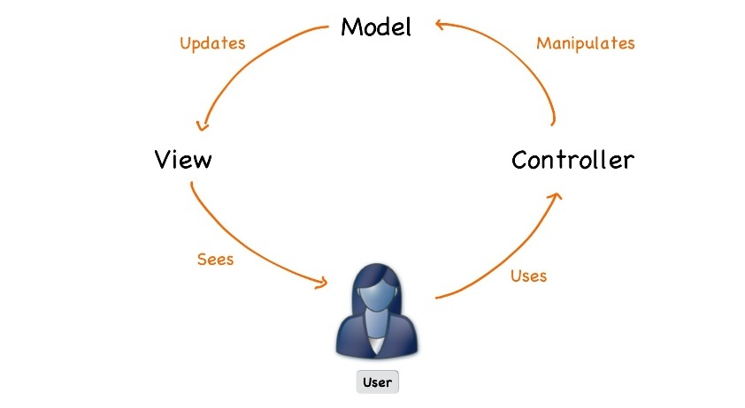



ASP.NET Core
Course Introduction
SoftUni Team
Technical Trainers
Software University
https://softuni.bg

Slide 2
Table of Contents
Course Objectives
Training and Team
Course Organization
Course Infrastructure
Evaluation Criteria
Resources

Slide 3
Questions
sli.do #csharp-web

Slide 4













SoftUni Diamond Partners

Slide 5


Educational Partners

Slide 6

Course Objectives

Slide 7
ASP.NET Core Course Content (1)
Essentials of ASP.NET Core
Razor View Engine
Application Flow, Filters and Middleware
Working with Data
Web API
Security and Identity

Slide 8
ASP.NET Core Course Content (2)
Testing
Project Architecture
SignalR
Azure, Deployment and Continuous Integration
Blazor

Slide 9
Exam – Project Defense
Implementing a web application with:
ASP.NET Core 6.0
Public defense of its work in front of a trainer
10 – 15 minutes
Demonstrate how the app works (very short)
Show the source code and explain how it works
Answer questions related to the project

Slide 10


Project Challenge
The three best projects will win a discount for the next course (professional / open program)
First place – 80% of the price
Second place – 50% of the price
Third place – 30% of the price
80%
50%
30%

Slide 11

Trainers

Slide 12
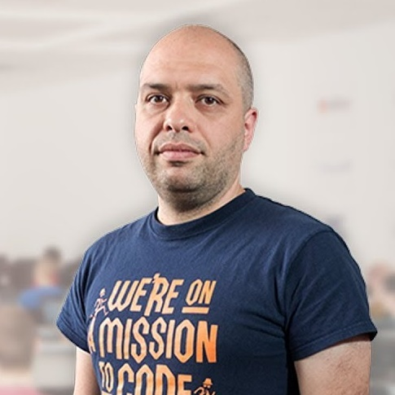
Stamo Petkov
Head Of Department at Information Services Plc.
Worked with various technologies
.NET and C#, BASIC, Pascal, Object Pascal, PHP
More than 15 years of experience
Experienced Lecturer
C# Basics and ASP.NET MVC @ Softuni

Slide 13

Course Organization

Slide 14
ASP.NET Core Course at SoftUni – Timeline
23-Feb-2022
17-Apr-2022
30-Apr-2022
ASP.NET Core
7 weeks * 2 times / week
18 credits
Start: 23-Feb-2022
Project Defense: 17-Apr-2022
Project Defense Retake: 30-Apr-2022

Slide 15

Course Workflow
Live coding
You no longer have homework
Fix bugs and implement features in the custom MVC framework
Work with GitHub
Groups of lectures are followed by workshops
Knowledge is used to extend an application
Best practices are applied

Slide 16


SoftUni Certificate
Practical Exam 100%
Evaluation
16

Slide 17
CPE Certificate
Practical Exam
Theoretical Exam
Evaluation
17

Slide 18
Questions?
Notes:
18

Slide 19



Course Web Site, Forum and FB Group
Official web site:
Official discussion forum:
Official Facebook groups:
https://softuni.bg/trainings/3601/asp-dot-net-core-february-2022
https://softuni.bg/forum/categories/66/csharp-web-development-basics
https://www.facebook.com/groups/CsharpWebJanuary2022

Slide 20
Trainings @ Software University (SoftUni)
Software University – High-Quality Education, Profession and Job for Software Developers
softuni.bg, softuni.org
Software University Foundation
softuni.foundation
Software University @ Facebook
facebook.com/SoftwareUniversity
Software University Forums
forum.softuni.bg
Notes:
20

Slide 21

License
This course (slides, examples, demos, exercises, homework, documents, videos and other assets) is copyrighted content
Unauthorized copy, reproduction or use is illegal
© SoftUni – https://softuni.org
© Software University – https://softuni.bg
Notes:
21

